Slide 1
Service Catalog
Service Catalog

Slide 2
What is Service Catalog
Service Catalog. With the Service Now Service Catalog application,
Create service catalogs that provide your customers with self-service opportunities.
Customize portals where your customers can request catalog items such as service and product offerings.
The Service Catalogue is the only part of the ITIL Service Portfolio published to Customers,
It is used to support the sale and delivery of IT Services.
The Service Catalogue includes information about deliverables, prices, contact points, ordering and request Processes.

Slide 3
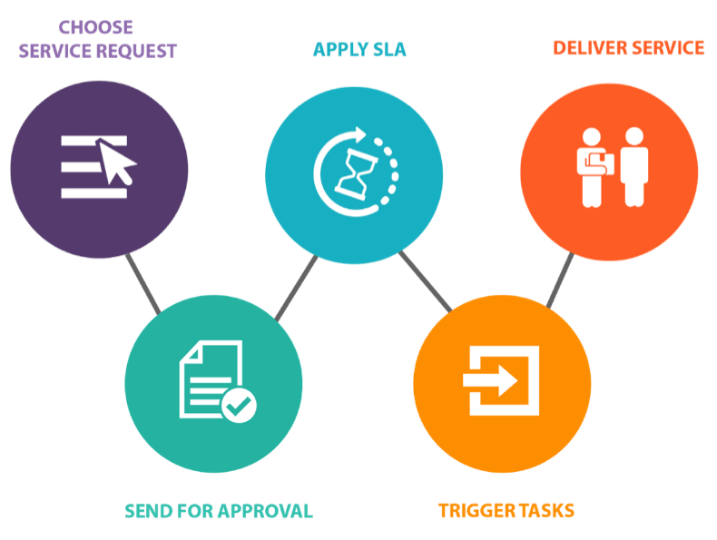
What is Service Catalog
Customize portals where your customers can request catalog items such as service and product offerings.
With the Service Catalog application, you can create one or more multiple catalogs of products and shared services
Catalog items are goods or services available to order from the service catalog. Items can be anything from Hardware, like tablets and phones, to software applications, to furniture and office supplies.

Slide 4

Service Catalog offers to(Contd.)
Service Catalog contain almost anything
Products like computer equipment,
Software,
Furniture
Office supplies
Service like work requests,
Password reset
Support to resolve incidents
Record producers
Order guides
Workflows

Slide 5
Service Catalog Categories
The products and services in a catalog are organized into categories and sub
categories
The base system includes several useful categories, and you can define your own
Computers
Laptops
Desktops
Ios
Service Catalog
Hardware
Tablets
Android
Mobile Phones
IPhone
Other

Slide 6
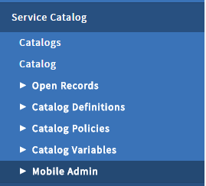
Service Catalog
Task
Request Item
Task
Request
Request Item
Task
Task

Slide 7
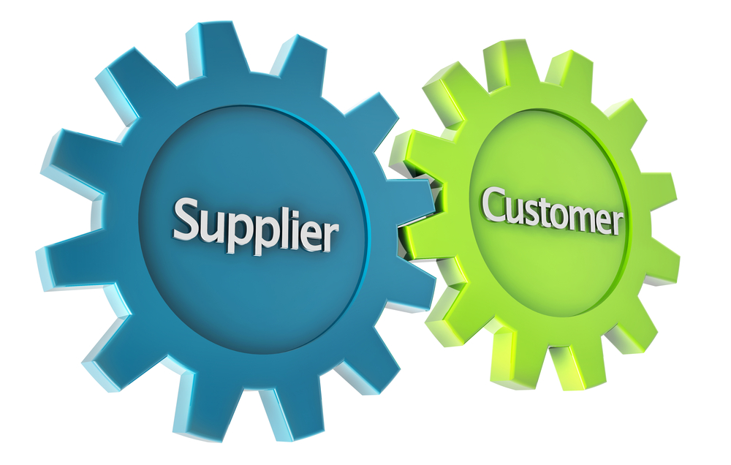


Creating Service Catalog Categories
Service Catalogs are catalogs of products and services that organization offers to
Employees
Customers
Suppliers
Others

Slide 8
Service Catalog Categories
The products and service in a catalog are organized into categories
Categories are organized in a tree structure, with parent categories containing one or more child categories
To order an item in a service catalog, users navigate through the categories to find the specific items they want
Laptops
Computers
Desktops
Ios
Service Catalog
Hardware
Tablets
Android
IPhone
Mobile Phones
Other

Slide 9




Who configure the Categories
Administrators and catalog administrators can create and configure categories in any service catalog, and add catalog items to them
Administrator
(Admin)
Catalog Administrator
(Catalog_Admin)
Catalog managers and catalog editors can also create and configure categories, but only within catalogs to which they are assigned
Catalog Manager
(Catalog_Manager)
Catalog Editor
(Catalog_Editor)

Slide 10



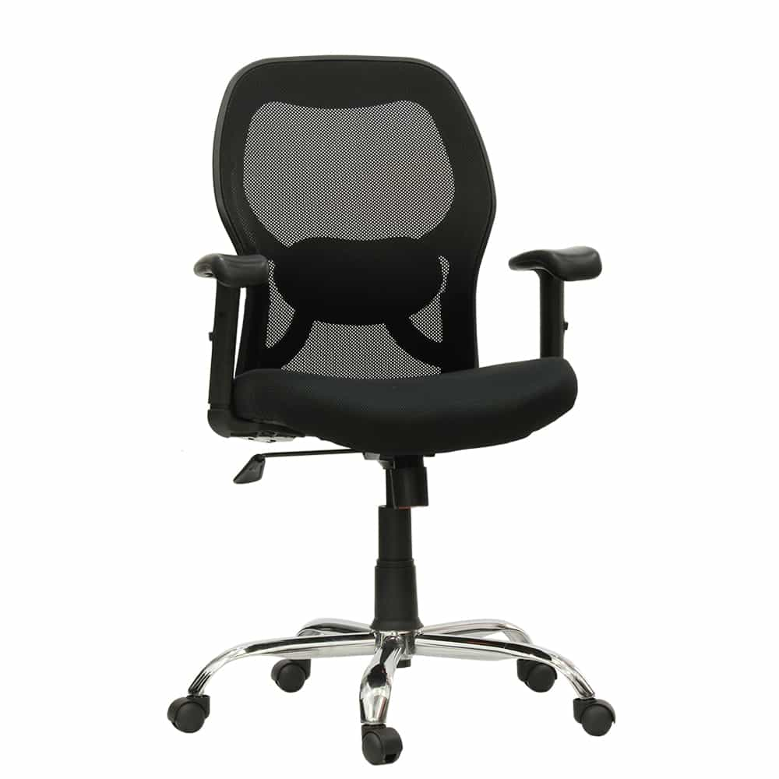
What is catalog Item
Items can be anything from hardware, like tablets and phones, to software applications, to furniture and office supplies.
Users order goods and services from the service catalog through catalog items; for example, a new laptop, or software installation, or office furniture

Slide 11
What is variable in Service catalog
Service catalog variables capture and pass on information about choices a customer makes when ordering a catalog item.
Variables help define the structure of a catalog item form that is displayed to the customer.
Service Catalog provides several types of variables, which are also referred to as questions. Variables can be stored, accessed from multiple places,
Catalog items may contain variables that a user specify to fulfill the request

Slide 12

Example for variable
For example, to install software, we need to know the type of computer the user has or its operating system
Catalog items are grouped into categories and subcategories to help users find what they are looking for exactly
Categories also ensure that the appropriate teams are assigned to fulfill orders
OS
MAC or PC?

Slide 13
What is Record Producer
A record producer is a specific type of catalog item that allows end users to create task-based records,
Such as incident records, from the service catalog.
Record producer is using to simplified form
Record producers allow you to standardize user requests.

Slide 14
Who configure the Record Producers
Catalog managers and catalog editors can also access their assigned Record producers in service catalog
Service Catalog→Catalog Definations→My Record Poducers
Catalog Manager
(Catalog_Manager)
Catalog Editor
(Catalog_Editor)

Slide 15




Execution plans and workflows
In this chapter we will introduces request fulfillment in service catalog, through Execution plans or Workflows
Introduction to Service catalog request filling the form
Execution plan Vs. Workflows
Creating execution plan
Creating an Workflow
Request filling
the form
Execution plan
Vs.
Workflows
Creating an
Workflow
Creating
execution plan

Slide 16



Execution plans
When someone orders an item or requests a service from service catalog, various people and groups in your organization perform a series of activities to fulfill the request
Procure Team
Laptop Request
2nd
4th
1st
3rd
Employee
Deliver Team
Manager Approved
Software Configure Team

Slide 17
Execution plans(Contd.)
Execution plans enable you to define simple linear processes consisting of a set of task
Each task specify the activity and people who perform the task
Here we have an example of a execution plan for delivering a corporate standard PC
Approve
Procure
Configure
Delivered

Slide 18



Execution Plans Steps
First a user submits a new request in the service catalog and a manager approves it
Approve
Procure
Configure
Deliver
Manager
User

Slide 19
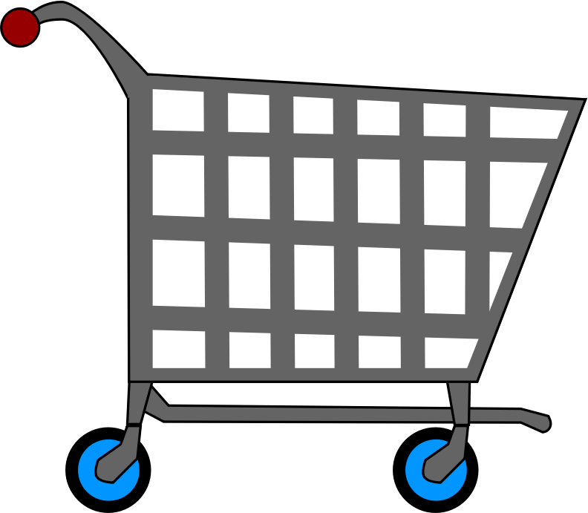


Execution Plans Steps
Second the procurement department obtains the computer from a supplier
Approve
Procure
Configure
Deliver

Slide 20

Execution Plans Steps
Next the IT software department team configures the standard software on the computer
Approve
Procure
Configure
Deliver
Software Installation

Slide 21

Execution Plans Steps
And finally the IT hardware team will installs the computer at the employee desktop
Approve
Procure
Configure
Deliver
Configure computer at Employee desk

Slide 22
What is order Guide
Order guides allow the customers to answer a series of questions
Resulting in one or more products or services being requested
This will avoids the need for customers to know specifically what products and services they required
Ensure that costumers request the right items leads to improved service provider efficiency and greater customer satisfaction

Slide 23
Overview of order Guide
In this chapter we can see how a self-service user request equipment through an order guide
Show how to create and setup an new order guide

